Slide 1

Le développement des partenariats
Biotech- Pharma entre la Chine et l’Europe
Conférence « Actualités du licensing 2018 »
Paris, 04-12-2018
LIYA JU, MD, PhD
Chief Operator Officer, PreciMed, Paris
Juliya_eiffel@126.c0m

Slide 2
JU Liya, MD, PhD
Medical immunologist
Senior Researcher in Immunogenetics an pharacogenetics
Doctor in Immunology (Institut Pasteur) at Jean Dausset Laboratory Paris
Deputy director of Sino-French HLA-Dausset Technology center Shanghai
Former Medical Director of Debiopharm China
Special representative for international Franco-Chinese Medical relation of Assistance Publique- Hopitals de Paris
Firstly discovered the association of MHC and drug side-effects in 1994
Chief Operator Officer of PreciMed Platform France

Slide 3
Quelques mots sur la Chine

Slide 4
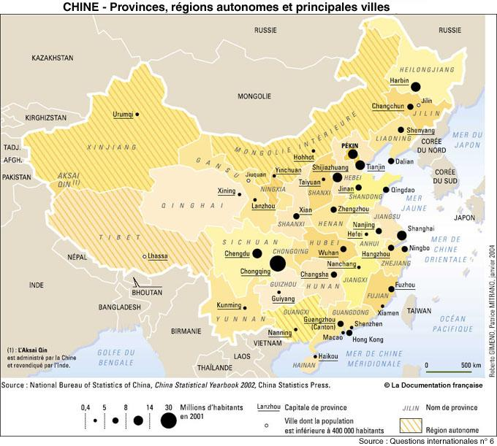

Slide 5
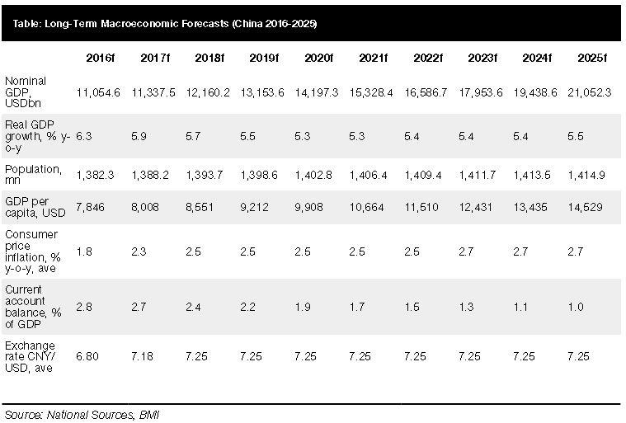
2016-2025 Long term forecasts of China macroeconomic

Slide 6

China - Share Of GDP By Each Region 2016
Source: NBS, BMI 2016.6

Slide 7
China Hospital Data
 | 2012 | 2013 | 2014 | 2015 | 2016
General Hospitals | 13 681 | 14 328 | 15 021 | 15 887 | 16 524
Specialized Hospital | 3 956 | 4 283 | 4 665 | 5 127 | 5 478
The centers for disease control and prevention | 3513 | 3484 | 3490 | 3516 | 3490
Hospital of Traditional Chinese Medicine | 2778 | 2831 | 2889 | 3015 | 3115
Maternal and child health hospital | 3025 | 3036 | 3044 | 3144 | 3098
Source: National Bureau of Statistics of China 2016.6.30

Slide 8
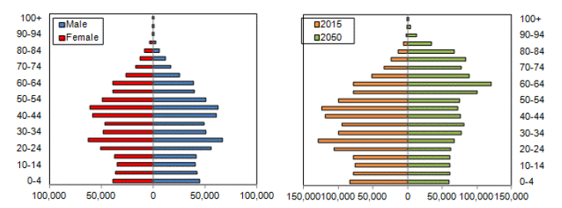
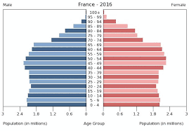
China population
China Population Pyramid
2015 vs 2050
Source: BMI2016.6

Slide 9
China Pharmaceutical market overview
China is 2nd pharmaceutical market, after US
Local generic pharmaceuticals have high sales volumes and lower prices but are of poorer quality than imported off-patent medicines, which is the major segment in which foreign companies are competing.
The pharmaceutical sector is highly dependent on government policies and on health reforms .
The government is trying to guarantee the sector’s healthy development through various measures, such as drug price liberalization, encouragement of consolidation among local companies, anti-corruption measures, and obligatory certification for drug manufacturing and sales practices.

Slide 10
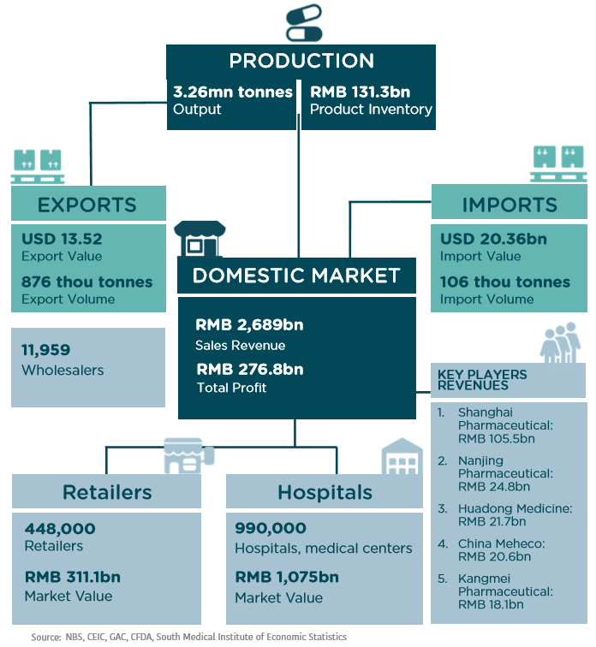
Pharmaceutical sector snapshot
12 X
Difference on price
Notes:
1) Shanghai pharma 130 Mds revenue. Nanjing Pharma; 3, huadong medecine = hangzhou kangmei = guangdong puning

Slide 11
General health of the population
  Industrialization drives economic growth, but also threatens health ( eg. air quality, polluted water, and occupational diseases)
The size, natural increase, and age distribution of the population
  Older adults tend to be major users of hospital services. According to the China Health Statistics Yearbook, the polutation >65 years
  - 1953 = 4.4%; 2014 = 10.1% ; 2050 =23.1%
Level and coverage of health insurance
  Health insurance can reduce direct cost to patients of hospital care, which boosts overall demand.
Hospital service
  The hospital purchasing power is increasing, more establishment are able to install different types od diagnostic equipment, create demand.
Healthcare sector reform
Per capita income growth
Demand Determinants
Notes:
如果以65岁及以上老年人口占总人口比例这一指标来测算的话，让这一比例从7%增加到14%，新加坡需要19年，中国需要26年，而美国需要69年，法国需要115年

Slide 12
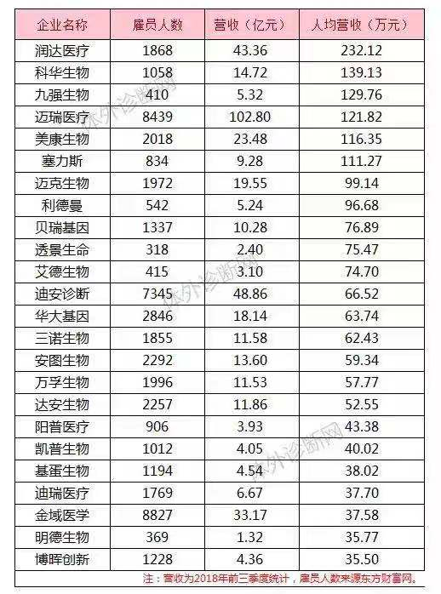
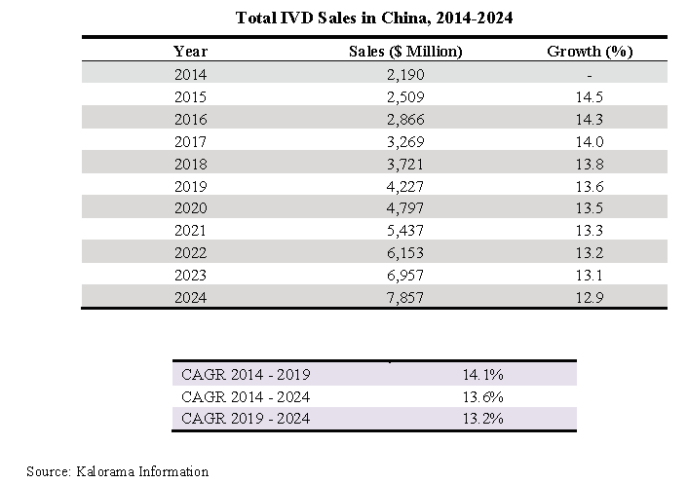
In 2014, the In vitro diagnostic (IVD) market in China was estimated at $2,190 million and is expected to show annual growth of 14.1% to reach $4,227 million in 2019
CAGR (Compound annual growth rate)

Slide 13
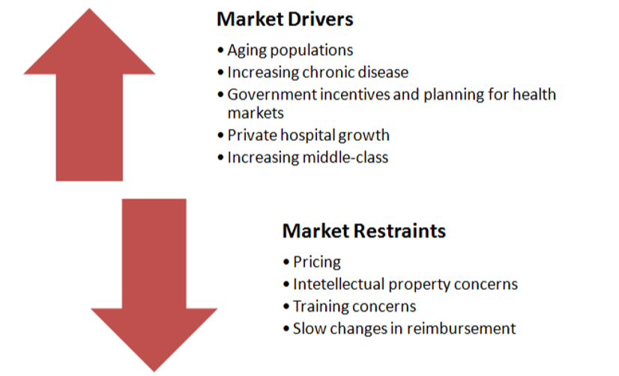
IVD industry increasing gross driver

Slide 14





Barriers to enter China
Ex : oxaliplatine en chine

Slide 15
The new situation of investment in China
China is consolidating the small funds and private equities, with the US economic battle, the private investment situation is not very positive. So they start to combine gov. fund.
On the contrary, government funds and industrial zone are having their “spring” moment, as the good projects can hardly get help from private.
Government registration guideline are changing frequently. Having gov. relation is a great advantage.
Angel /round 1 investment conditions and connections are essential.
The investment policy are varies and guideline are different between cities(not provincial level neither country level)

Slide 16

PreciMed
PreciMed France (Consulting Precision Medicine) has established by three well known professors: Liya JU, COO; Dominique Charron (APHP, Jean Dausset Lab) and Jean-Pierre Armand(Gustave Roussy).
PreciMed China has strong team combines Government relation, Fund investor, association leader, Chinese and French KOL, list companies and commercial force ( cancer and immuno domains+++).
Helping European biotech/ETI to open Chinese market & refinancing project company.
Helping Chinese list companies to have advanced hi-tech bio products to enhance their product portfolio.

Slide 17
PreciMed Projects supporting system
PreciMed France
&
PreciMed China Team
Chinese Regional Government Branch (Industrial Zone)
Government fund and easy access policies
Manufacture investment
Private fund
Project follow up support including clinical trial help and sales/management team support
List Pharma Companies network/institute
(Top 10)
Angel investment
&
List company school/club

Slide 18
PreciMed Successful Strategy
European Company
Plateform
Industrial Zone/list company
Funds
Government help
Joint Venture with IP
Sales team form
Registeration experts team
Sales before registed
Free factory land & machines
Domestic KOL support
Quality and tech transfer

Slide 19
Advantage of
PreciMed
Strong connection with all Healthcare list companies (Fudan investment commercial institute and stock exchange company's combination club)
financial support(industrial zones funds and listed companies' funds)
Strong government relations.(Tsinghua, Suzhou, Shanghai, Canton etc.) Good industrial zones cooperation(good investment policy with best conditions and financing advantage), registration access.
manufacturing site condition advantage(location, decoration, tax refund, etc)
talent expert special support for the expats talents.
sales network. Mature distribution network for biotech and pharma) and management team and channel force.

Slide 20

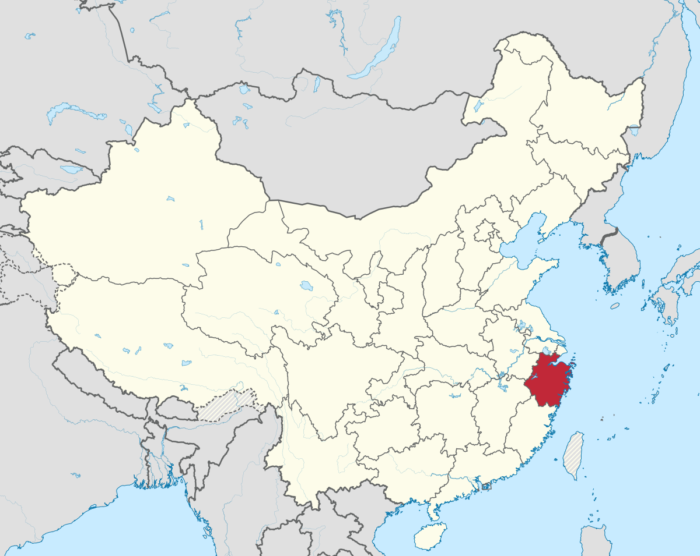
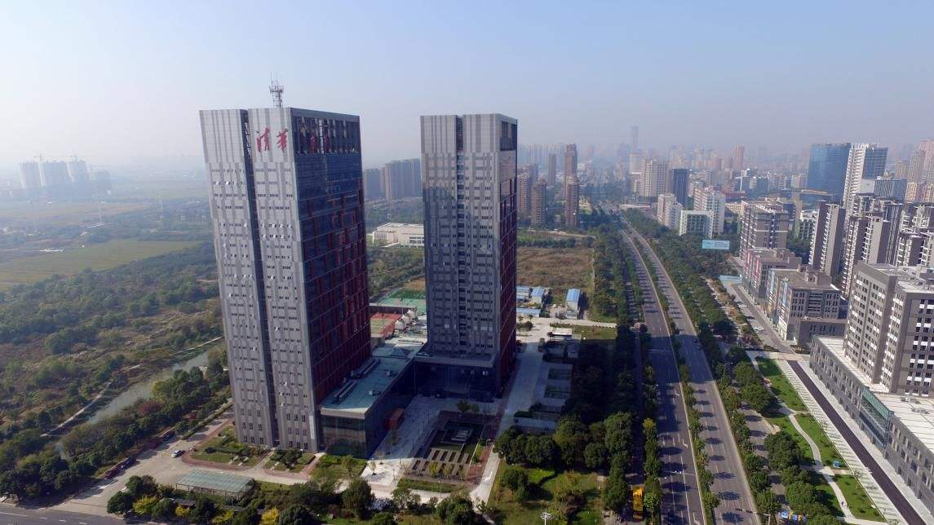
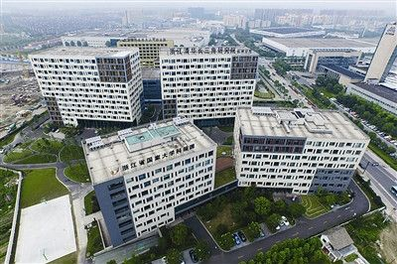
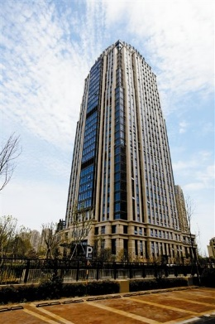
Our partner- Industrial zone example 1
Institute is established by Zhejiang Gov and Tsinghua Univ, the Dean is Major level in government rank.
Yangtze Delta Region institute of Tsinghua Univ has nine Industrial zone which covers nine service platform. In last 3 years, it had already incubated 328 companies, invested in 162 companies. 5 companies had more than 1 Billion RMB (12 million Euro) evaluation and 1 company has 10 Billion (120 Million Euro) evaluation.
Tsinghua Univ
Zhejiang Gov
Policy support
Business Cop
R&D Platform
Gov. Fund
Innov Base
嘉兴产业基地
杭州产业基地
宁波产业基地

Slide 21
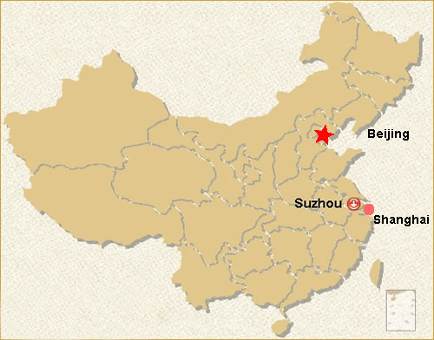
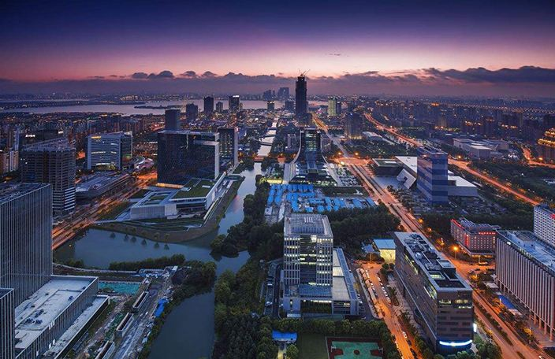
Our partner- Industrial zone example 2
Suzhou Industrial Zone
Suzhou Industrial zone is a national level industrial zone and international enterprises incubator example.
Highly support by local government from political aspect and fund aspect.
Willing to have recommended project as a package to benefit best advantage policies and support companies to localize in Suzhou. The gov will support in registration, funds, land, tax refund etc.
Ex. In 2 years , 50 more small and medium size company had located in this area, includes around 50% international JV.

Slide 22
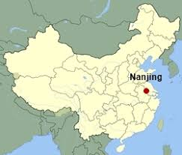
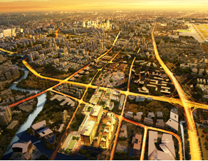
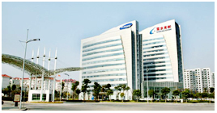

Our Industrial zone example 3
Nanjing Jiangbei Hitech
Nanjing Jiangbei Hitech zone is a national level industrial zone, supported by both provincial level policies and Central policies.
30 Billion RMB funds and more will come to support international JV / Local high tech companies to develop.
Highly support by local government from healthcare products registration and market access.
In 4 years more than 100 projects located there, highly international hi-tech level.
(city with Top 2 pharma China)

Slide 23
PreciMed aiming projects
Precision diagnostic：
  - Hi-technology and equipment
New Drug , immune therapy, Genome Therapy：
  - new drug (phase 1/2/3; RD companies)
Clinical application, big data
AI, MedTech

Slide 24
PreciMed Successful case
European company specialized in allergy area, with advantage products which covers all general allergens and has quantification results.
Barriers:
- registration: need 1000 clinical case per allergen prove in at least three appointed hospitals.
- company starts investment.
- manufacture localize in China.
- Chinese management team.
- sales channel and distribution network before and after registration.
- domestic KOL support for marketing and academic side.

Slide 25
Trouble cases
France famous Pharmaceutical company with 2 patent new drugs….
With conditions too constraining for their French developers, the founds raised for clinical trial in China failed
Reasonable expectation and develop together is the only way to get Chinese market.
Fair case and good willing with no regret partnership

Slide 26
Fund exit plan
IPO (ex.Shanghai science and technology board, can be consider as Chinese NASDAQ)
  Fast , no need positive profit to enter
  New government trend
  PreciMed’s help to follow up
China IPO, Hongkong IPO etc.
M&A with list company
  IP
  Know-how
  Shares / cooperation
Shares purchasing
Multiple way for partnership plan

Slide 27
PreciMed Accelerator
Healthcare project network in China
Strong Gov support
Local gov. support (Green gate)of hi-tech healthcare related projects.
Trustful international Team
Sales , marketing, registeration, manufacture team with local gov. & experts support to ensure the success of projects
List company group support
When the project present in china, will be present to all healthcare list company, Financing, Sales and RD support.
Funds support
Several funds support and also gov resources to accelerate the projects localization.
Juliya_eiffel@126.com;
Contact.precimed@gmail.com
+336 84 62 61 75 wechat: juliya75013

Slide 28
Merci
Travaillons ensemble
Pour trouver
les solutions

